Slide 1
Agile Model and Methodology
Presented By:-
Rajat Nagil
Ekta Sharma
Kavish Sharma
Simran Kaur

Slide 2
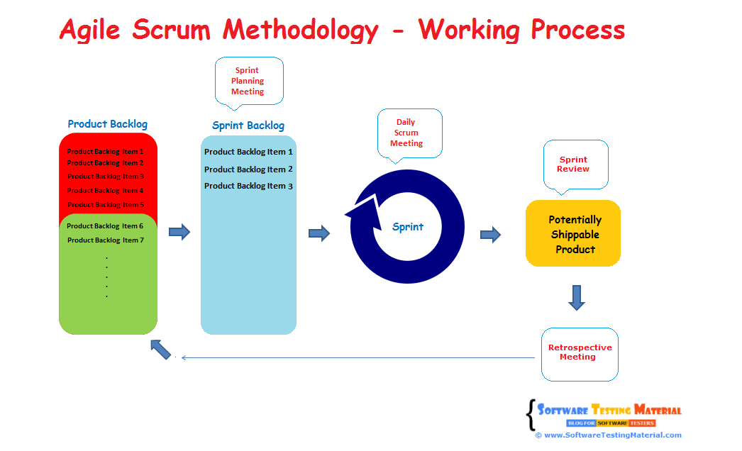
Agile Technology
Agile Scrum Methodology is one of the popular Agile software development methods. There are some other Agile software development methods but the popular one which is using widely is Agile Scrum Methodology. The Agile Scrum Methodology is a combination of both Incremental and Iterative model for managing product development.

Slide 3
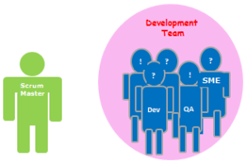
Scrum Master
Scrum Master acts as a facilitator to the Scrum Development Team. Clarifies the queries and organizes the team from distractions and teach team how to use scrum and also concentrates on Return on Investment (ROI).

Slide 4
User Stories
User Stories are not like a traditional requirement documents. In User Stories, stake holder mention what features they need and what they want to achieve.

Slide 5
Sprint Planning
Sprint planning is a timeboxed working session that lasts roughly 1 hour for every week of a sprint. In sprint planning, the entire team agrees to complete a set of product backlog items. This agreement defines the sprint backlog and is based on the team’s velocity or capacity and the length of the sprint.

Slide 6
Retrospection
An Agile retrospective is a meeting that's held at the end of an iteration in Agile software development (ASD). During the retrospective, the team reflects on what happened in the iteration and identifies actions for improvement going forward.

Slide 7
Burndown Chart
A burn down chart is a graphical representation of work left to do versus time. The outstanding work (or backlog) is often on the vertical axis, with time along the horizontal. That is, it is a run chart of outstanding work. It is useful for predicting when all of the work will be completed. It is often used in agile software development methodologies such as Scrum. However, burn down charts can be applied to any project containing measurable progress over time.

Slide 8
Planning Poker
Planning poker, also called Scrum poker, is a consensus-based, gamified technique for estimating, mostly used to estimate effort or relative size of development goals in software development. In planning poker, members of the group make estimates by playing numbered cards face-down to the table, instead of speaking them aloud. The cards are revealed, and the estimates are then discussed. By hiding the figures in this way, the group can avoid the cognitive bias of anchoring, where the first number spoken aloud sets a precedent for subsequent estimates.

Slide 9
Daily Stand-up
Daily Scrum is also known as Daily Stand-up meeting. Here each team member reports to the peer team member on what he/she did yesterday, what he/she going to do today and what obstacles are impeding in their progress. Reporting will be between peers not to Scrum Master or Product Owner. Daily Scrum will be approximately 15 mins.

Slide 10
Scrum Board
In Scrum the task board is a visual display of the progress of the Scrum team during a sprint. It presents a snapshot of the current sprint backlog allowing everyone to see which tasks remain to be started, which are in progress and which are done.

Slide 11
Kanban
Kanban is an agile methodology that is not necessarily iterative. Processes like Scrum have short iterations which mimic a project lifecycle on a small scale, having a distinct beginning and end for each iteration. Kanban allows the software be developed in one large development cycle. Despite this, Kanban is an example of an agile methodology because it fulfils all twelve of the principles behind the Agile manifesto, because whilst it is not iterative, it is incremental.

Slide 12
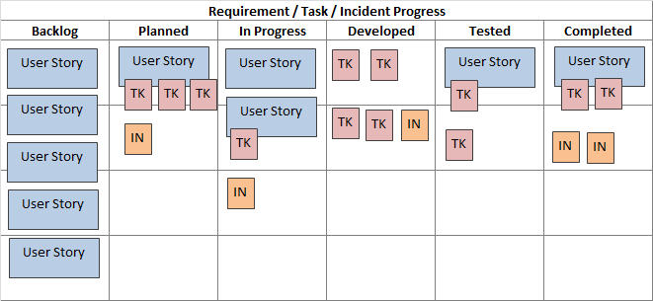
Kanban Process

Slide 13
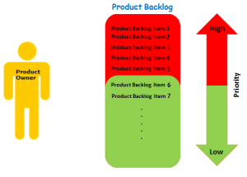
Product Owner
Product Owner usually represents the Client and acts as a point of contact from Client side. The one who prioritizes the list of Product Backlogs which Scrum Team should finish and release.

Slide 14
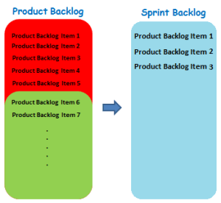
Sprint Backlog
Group of user stories which scrum development team agreed to do during the current sprint (Committed Product Backlog items)

Slide 15
Velocity
Velocity is a measure of the amount of work a Team can tackle during a single Sprint and is the key metric in Scrum. Velocity is calculated at the end of the Sprint by totaling the Points for all fully completed User Stories.

Slide 16
Jira
JIRA is a tool developed by Australian Company Atlassian. It is used for bug tracking, issue tracking,and project management. The name "JIRA" is actually inherited from the Japanese word "Gojira" which means "Godzilla".
The basic use of this tool is to track issue and bugs related to your software and Mobile apps. It is also used for project management. The JIRA dashboard consists of many useful functions and features which make handling of issues easy.

